Slide 1



Electrical Engineering Department
JECRC , Jaipur
TESLA 11/17
TESLA 11/17
November
2017

Slide 2

TESLA
11/17
What’s
Inside....??
1. Director’s message
2. Principal’s message
3. HOD’s message
4. Vision, Mission of Institute
5. Vision, Mission of Department
6. Program Outcomes
7. Placement Drives
8. Faculty’s Achievements
9.. Student’s Achievements
10. Editorial Board

Slide 3

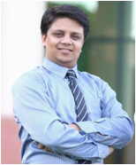

TESLA 11/17
Director JECRC, Jaipur
Message
The JECRC Foundation has been established with a view to provide world class education to our young minds so that they can shoulder their global responsibilities in the years to come.
The JECRC Foundation, now 18 years old, has established itself as one of the leading self-financed colleges in Northen India. This has been primarily due to the large significance that the college puts on the teaching learning process.
The focused areas at JECRC now, apart from teaching learning and placement would be research and development, entrepreneurship and outreach. We also strive to help our students in maintaining and spreading the rich Indian culture and lead the world as our country has done in the past. As you move ahead and rise higher in your life, you must entrench yourself in this unique realm that our culture endows us.
I wish to convey my greetings to all our Alumni and wish each one of them all success in their personal and professional lives.
Best Wishes
Mr. Arpit Agrawal
Director
JECRC, Jaipur

Slide 4
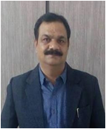
TESLA 11/17
Principal JECRC, Jaipur
Message
A desire can change nothing, a destination can change something but a determination can change everything. Life is a set of problems, an engineer has to solve the problems in their domain areas with strong innovative ideas and scientific knowledge. Your commitment to become an engineer by denoting your journey in Jaipur Engineering College and Research Center will be fruitful and enjoyable in every aspect, the experience you gain from here and the moments you spend here.
Best Wishes
Dr. V. K. Chandna
Principal
JECRC, Jaipur

Slide 5
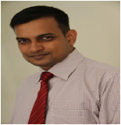
TESLA 11/17
HOD (EE)
JECRC, Jaipur
Message
Nikola Tesla, the well known Serbian- American electrical engineer is quoted as saying "Electrical sources has revealed to us the true nature of light has provided us with innumerate appliances and instruments of precision and has thereby vastly added to the exactness of our knowledge". His words portray the immensely wide and dynamically changing and ever developing world of electrical engineering open to electrical engineer.
It is a great pleasure to see the November, 2017 issue of EE newsletter “Tesla 11/17”. The department has well qualified staff with expertise in Power Systems, Control Systems, Power Electronics and Drives, Electrical Machines and Renewable Energy System assisted by skilled supporting staff. I would like to thank my existing team for their commitment and hard work. The department seeks to combine excellence in education and research. The core values of the department help the students to develop the students their overall personality and made them worthy technocrat to compete and work at global level. Our department has been conducting hands on workshop/seminar/training program since its beginning to keep the faculty and students to enhance the knowledge in their domain.Our mission includes a commitment to prepare students for professional and research activities with an ability to learn independently. I wish you all a successful, long-lived, engineering-based career path.
Best Wishes
Dr. Sandeep Vyas
HOD, Electrical Engineering
JECRC, Jaipur

Slide 6

Vision of the Institute
TESLA 11/17
To become a renowned centre of outcome based learning, work towards academic, professional, cultural and social enrichment of lives and communities .
Mission of the Institute
Focus on evaluation of learning outcomes and motivate student to inculcate research aptitude by project based learning.
Identify, based on informed perception of Indian, regional and global needs, the areas of focus and provide platform to gain knowledge and solution.
Offer opportunities for interaction between academia and industry.
Develop human potential to its fullest extent so that intellectually capable and imaginatively gifted leaders may emerge in the range of profession.

Slide 7
Vision of Department
TESLA 03/18
To Emerge as a Centre of Excellence in teaching in the area of Electrical Engineering; to serve as a valuable resource for society by promoting excellence.
Mission of Department
M1: To provide professional and ethical guidance to the students to make them employable .
M2: To improve quality of education through different quality development programs for faculty and students .
M3: To encourage students to acquire practical knowledge through projects and participation in national and international events .
M4: To prepare our students for upcoming challenges of life through guidance for competitive examinations .
4

Slide 8
TELSA
11/17
PROGRAM OUTCOMES
Engineering knowledge: Apply the knowledge of mathematics, science, engineering fundamentals, and an engineering specialization to the solution of complex engineering problems.
Problem analysis: Identify, formulate, research literature, and analyze complex engineering problems reaching substantiated conclusions using first principles of mathematics, natural sciences, and engineering sciences.
Design/development of solutions: Design solutions for complex
Engineering problems and processes that meet the
design system components or specified needs with appropriate
consideration for the public health and safety and the cultural, social, and environmental considerations.
Conduct investigations of complex problems: Use research-based knowledge and research methods including design of experiments, analysis and interpretation of data, and synthesis of the information to provide valid conclusions.
Modern tool usage: Create, select, and apply appropriate techniques, resources, and modern engineering and IT tools including prediction and modelling to complex engineering activities with an understanding of the limitations.
The engineer and society: Apply reasoning informed by the contextual knowledge to assess societal, health, safety, legal and cultural issues and the consequent responsibilities relevant to the professional engineering practice.
4

Slide 9
TESLA 11/17
Environment and sustainability: Understand the impact of the professional engineering solutions in societal and environmental contexts and demonstrate the knowledge of and need for sustainable development.
Ethics: Apply ethical principles and commit to professional ethics, responsibilities and norms of the engineering practice.
Individual and team work: Function effectively as an individual and as a member or leader in diverse teams, and in multidisciplinary settings.
Communication: Communicate effectively on complex engineering activities with the engineering community and with society at large, such as, being able to comprehend and write effective reports and design documentation, make effective presentations and give and receive clear instructions.
Project management and finance: Demonstrate knowledge and understanding of the engineering and management principles and apply these to one’s own work, as a member and leader in a team, to manage projects and in multidisciplinary environments.
Life-long learning: Recognize the need for, and have the preparation and ability to engage in independent and life-long learning in the broadest context of technological change.
4

Slide 10
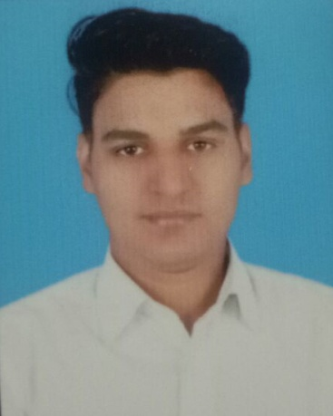
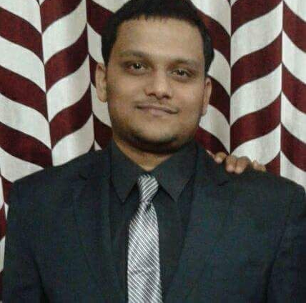
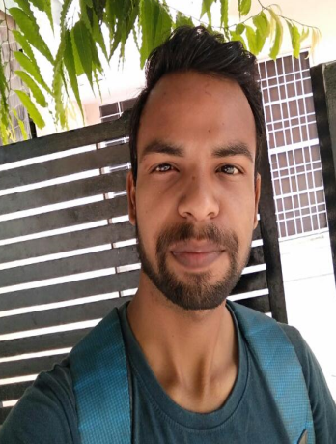
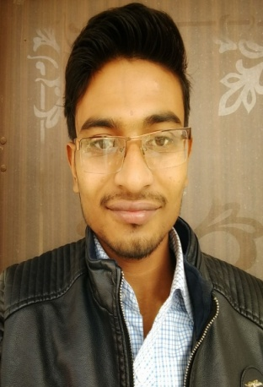
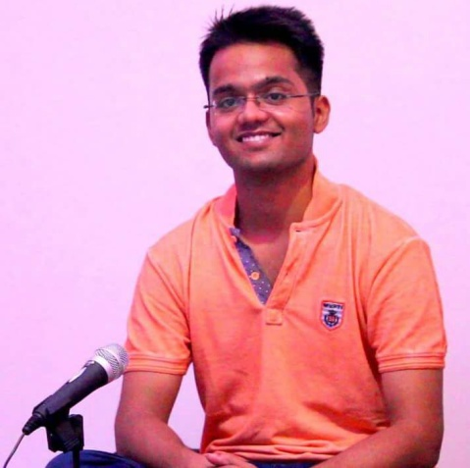
TELSA 11/17
PLACEMENT DRIVES
Capital Trust- On 1st Nov outset placement drive was organized by the Capital Trust Which included aptitude test then it was followed by GD and personal Interview. Four student were selected from the EE department named as Mr. Chitranjan Goutam Mr. Jayant Jha Mr. Mahavir Suman Mr. Rohit Kumar Gupta with the package of 1.8 LPA.
Devtechnosys Drive - On 2nd Nov outset placement drive was organized by Devtechnosys Which included aptitude test then it was followed by GD and personal Interview. Only one student was selected from the EE department named as Mr. Ashutosh Gaur with the package of 1.8 LPA.

Slide 11
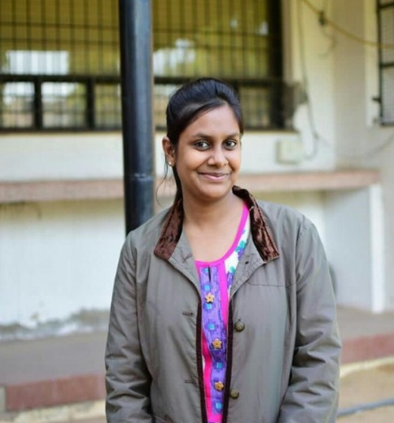
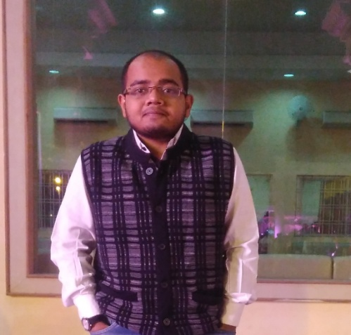
TELSA 11/17
Mind It- On 11th Nov outset placement drive was organized by Mind It Which included aptitude test then it was followed by GD and personal Interview. Only one student was selected from the EE department named as Ms. Akshita Mangal with the package of 1.8 LPA.
Off Campus Placement Drive- Vivek Agrawal was selected as a faculty of physics in Urmil Career Company with package of 3.6 LPA.

Slide 12
TESLA 11/17
FACULTY ACHIEVEMENTS
Publications-
Mr. Vishal Sharma
Paper Name-Modelling and performance analysis of DPFC on Multimachine System
Name Of Journal- European Journal of Advances in Engineering & Technology
Status(Communicated/Published)-Communicated on 5/11/17
ISSN No- 2394-658X
Mr. Shailendra Srivastava
Paper Name-Modelling and performance analysis of DPFC on Multimachine System
Name Of Journal- European Journal of Advances in Engineering & Technology
Status(Communicated/Published)- Communicated on 5/11/2017
ISSN No- 2394-658X
Mr. Shailendra Srivastava
Paper Name- Segmentation technique to detection Microcalcification in Mammograms
Name Of Conference- International Conference on Communication & Computational Technologies- 2017, Jaipur
Status(Communicated/Published)- Published on 8/11/17

Slide 13
TESLA 11/17
Ms. L. Senthil
Paper Name- Opportunity of Analysis and Assessment of CDM Potential in Residential Area
Name Of Journal- International Research Journal of Engineering & Technology, Trichy
Status(Communicated/Published)- Published on 20/11/17
ISSN No- 2395-0072, Volume 4/ Issue 11
Mrs.Sonali Chadha
Paper Name- Opportunity of Analysis and Assessment of CDM Potential in Residential Area
Name Of Conference/Journal- International Research Journal of Engineering & Technology, Trichy
Status(Communicated/Published)- Published on 20/11/17
ISSN No- 2395-0072, Volume 4/ Issue 11
Mr. Ram Singh
Paper Name-Review of Hybrid Solar Tower-Biomass in India
Name Of Journal- International Conference on Recent Innovation Trends in Engineering, Technology & Research
Status(Communicated/Published)-Accepted (Abstract) on 23/11/17
Mr Gopal Tiwari
Paper Name- Review of Hybrid Solar Tower-Biomass in India
Name Of Journal- International Conference on Recent Innovation Trends in Engineering, Technology & Research
Status(Communicated/Published)-Accepted (Abstract) on 23/11/17

Slide 14
TESLA 11/17
Ms. Ravita Saraswat
Paper Name- DG Integrated distribution system expansion planning with uncertainities
Name Of Conference/Journal- Signal Machine and Automation 2018, NSIT, Delhi
Status(Communicated/Published)-Communicated on 22/11/17
Mrs. Ravita Saraswat
Paper Name- Segmentation technique to detection Microcalcification in Mammograms
Name Of Conference- International Conference on Communication & Computational Technologies- 2017, Jaipur
Status(Communicated/Published)- Published on 8/11/17
Mrs. Ravita Saraswat
Paper Name- A Review of Renewable Energy System with various parameters
Name Of Journal- The Institution of Engineering and Technology
Status(Communicated/Published)-Communicated on 15/11/17
Mr. Rahul Kumar Malee
Paper Name- DG Integrated distribution system expansion planning with uncertainities
Name Of Conference/Journal- Signal Machine and Automation 2018, NSIT, Delhi
Status(Communicated/Published)-Communicated on 22/11/17

Slide 15
TESLA 11/17
Mr. Rahul Kumar Malee
Paper Name- Segmentation technique to detection Microcalcification in Mammograms
Name Of Conference- International Conference on Communication & Computational Technologies- 2017, Jaipur
Status(Communicated/Published)- Published on 8/11/17
Mr. Rahul Kumar Malee
Paper Name- A Review of Renewable Energy System with various parameters
Name Of Journal- The Institution of Engineering and Technology
Status(Communicated/Published)-Communicated on 15/11/17
Mr. Ashok Singh Chundawat
Paper Name- Segmentation technique to detection Microcalcification in Mammograms
Name Of Conference- International Conference on Communication & Computational Technologies- 2017, Jaipur
Status(Communicated/Published)- Published on 8/11/17
Mr. Ashok Singh Chundawat
Paper Name- DG Integrated distribution system expansion planning with uncertainities
Name Of Conference/Journal- Signal Machine and Automation 2018, NSIT, Delhi
Status(Communicated/Published)-Communicated on 22/11/17

Slide 16
TESLA 11/17
Ms. Neha Agrwal
Paper Name-Review of Hybrid Solar Tower-Biomass in India
Name Of Journal- International Conference on Recent Innovation Trends in Engineering, Technology & Research
Status(Communicated/Published)-Accepted (Abstract) on 23/11/17
Ms. Poonam Gupta
Paper Name-Opportunity of Analysis and Assessment of CDM Potential in Residential Area
Name Of Journal- International Research Journal of Engineering & Technology, Trichy
Status(Communicated/Published)- Published on 20/11/17
ISSN No- 2395-0072, Volume 4/ Issue 11
Mr. Manish Pal
Paper Name-GANAS Semiconductor material for solar photovoltaic
Name Of Journal- International Research Journal of Engineering & Technology, Trichy
Status(Communicated/Published)-Communicated on 30/11/17
ISSN No- 2395-0056, Volume 4/Issue 12
Mr. V D Sharma
Paper Name- Opportunity of Analysis and Assessment of CDM Potential in Residential Area
Name Of Journal- International Research Journal of Engineering & Technology, Trichy
Status(Communicated/Published)- Published on 20/11/17
ISSN No- 2395-0072, Volume 4/Issue11

Slide 17
TESLA 11/17
Mr. Sunil Sharma
Paper Name-Proposed Method to Control Load Frequency in Single Area Power System
Name Of Journal- International Research Journal of Engineering & Technology, Trichy
Status(Communicated/Published)- Published on 31/10/17
ISSN No- 2395-0072, Volume 4/ Issue 10
Mr.Atul Kulshrestha
Paper Name- Proposed Method to Control Load Frequency in Single Area Power System
Name Of Journal- International Research Journal of Engineering & Technology, Trichy
Status(Communicated/Published)- Published on 31/10/17
ISSN No- 2395-0072, Volume 4/ Issue 10
Ms. Suman Devi
Paper Name- Review of Hybrid Solar Tower-Biomass in India
Name Of Journal- International Conference on Recent Innovation Trends in Engineering, Technology & Research
Status(Communicated/Published)-Accepted (Abstract) on 23/11/17

Slide 18
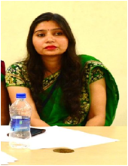
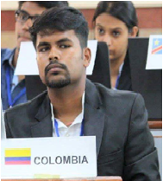
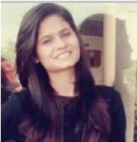
TESLA 11/17
EDITORIAL BOARD
Faculty Coordinator
Ms. Ravita Saraswat
Student Coordinator
Prakhar Joshi
Bharti Sharma

Slide 19
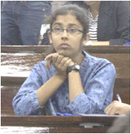
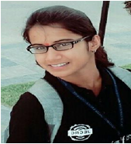
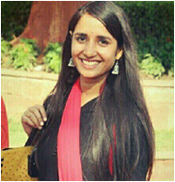
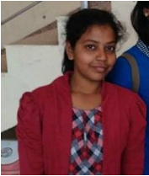
TESLA 11/17
Sakshi Sharma (3rd year)
Akanksha Sinha (3rd year)
Manu Sharma (3rd year)
Mridula Soni (3rd year)

Slide 20
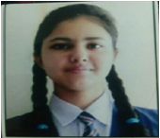
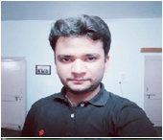

TESLA 11/17
Ujjwal Sharma (2nd year)
Shashwat Tripathi (2nd year)

